Slide 1
BehavIoT- Longitudinal Study
Goal of the Project-
Find out if a device frequently changes its behavior
Measure any deviations from the expected behavior
Find if the device needs a further investigation of whether there is any suspicious activity, so that such activity can be blocked.
By- Shubham Bhagwat and Siddhant Sukhatankar

Slide 2
Progress of the Project
Analyzed month-wise DNS and TLS traffic of the devices based on changes in destination domain names
Devices analyzed- Brewer, Roku-tv, Google home mini and iKettle
No significant domain name behavior change for most of the devices, except for the iKettle.

Slide 3
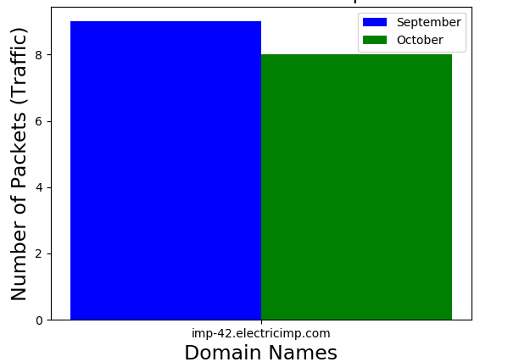
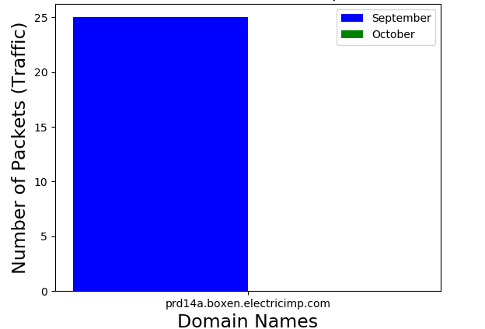
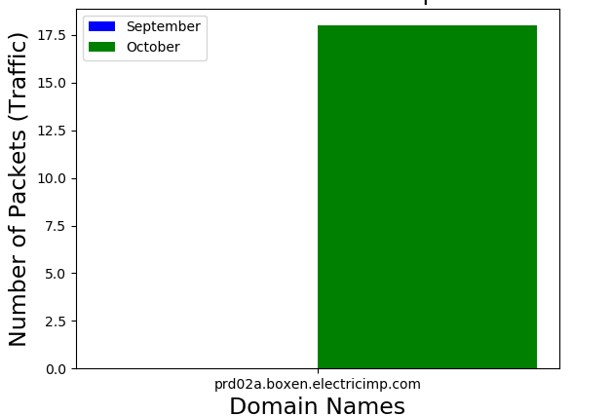
Change in the behavior of iKettle domain names

Slide 4
Further Goals
Replicating the analysis over 3 years of data.
Analyzing different IoT devices

